Slide 1
Introduction to Statistical Methods
Dr Y V K Ravi Kumar, BITS- Pilani

Slide 2
Session 1: Overview of the course
& Descriptive Statistics

Slide 3
Agenda
Data Visualization
Why ?
What?
How ?
Measure of Central Tendency
Mean
Mode
Median
Measures of Variability
Range
Standard Deviation
Variance
3

Slide 4
“When you can measure what you are speaking about and express in numbers, you know something about it ;but when you cannot measure it, cannot express it in numbers, your knowledge is of meagre and unsatisfactory kind”
Lord Kelvin

Slide 5
“Statistical thinking will be one day as necessary for efficient citizenship as the ability to read and write”
H G Wells

Slide 6
!!!!
A famous statistician would never travel by airplane, because she had studied air travel and estimated the probability of there being a bomb on any given flight was 1 in a million, and she was not prepared to accept these odds.
One day a colleague met her at a conference far from home.
"How did you get here, by train?"
"No, I flew"
"What about the possibility of a bomb?"
"Well, I began thinking that if the odds of one bomb are 1:million, then the odds of TWO bombs are (1/1,000,000) x (1/1,000,000) = 10⁻¹². This is a very, very small probability, which I can accept. So, now I bring my own bomb along!"

Slide 7
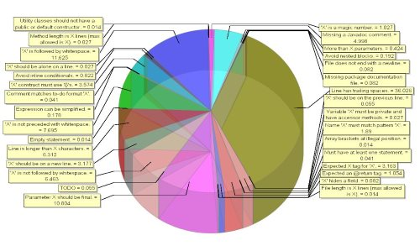

Slide 8
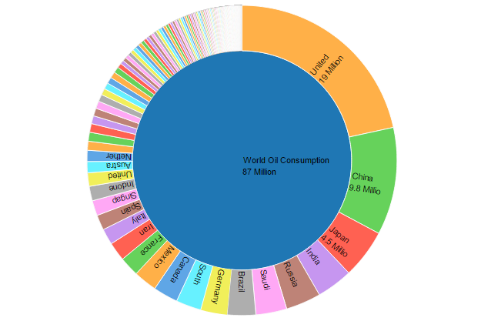

Slide 9
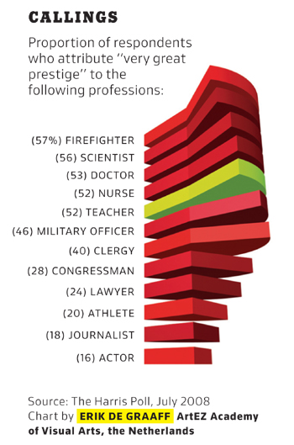

Slide 10
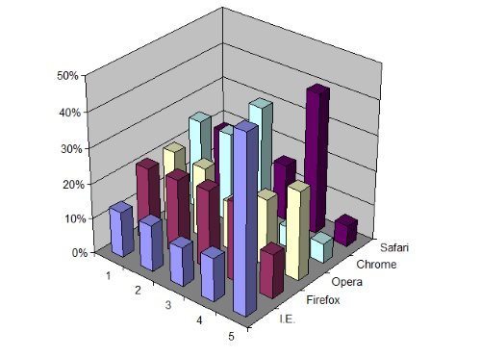

Slide 11
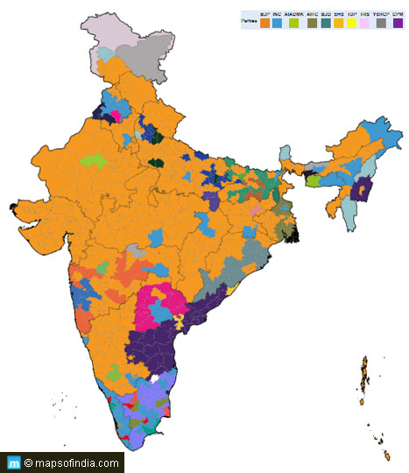

Slide 12
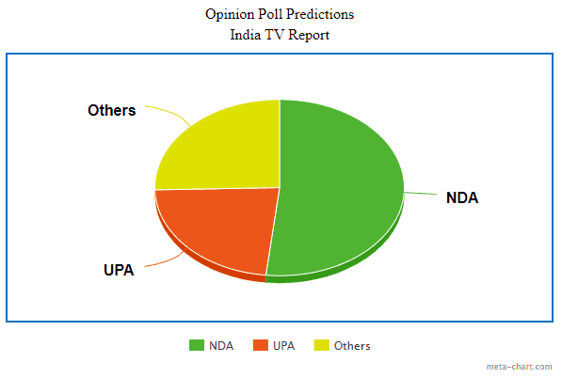

Slide 13
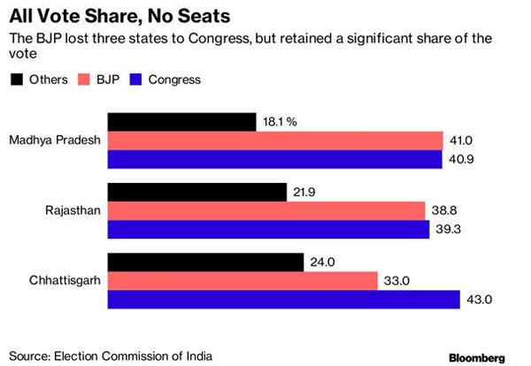

Slide 14
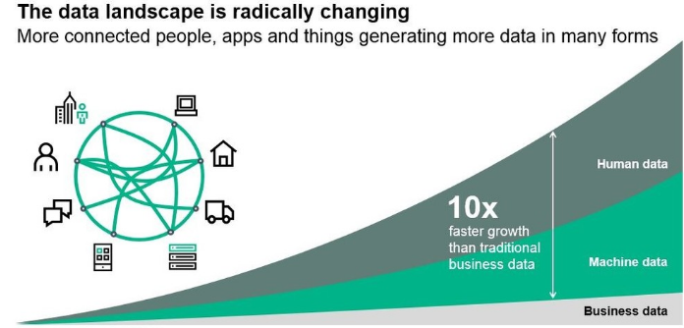
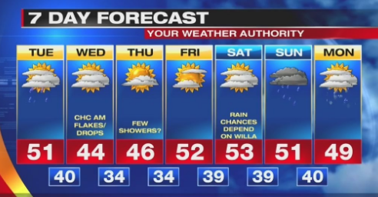
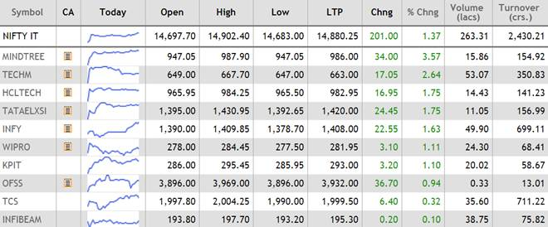
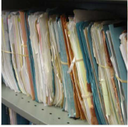
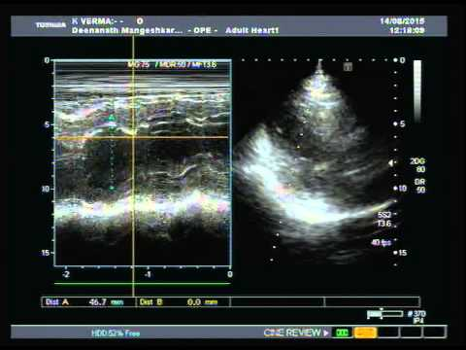
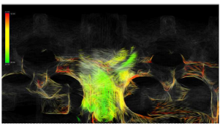
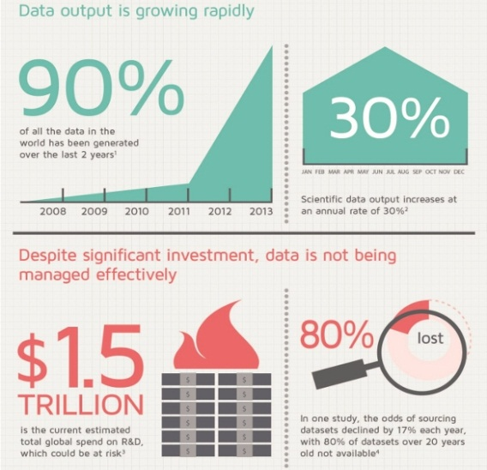

Data is generated everywhere …everyday …and is increasing exponentially
Source: http://3dsbiovia.com/blog/

Slide 15
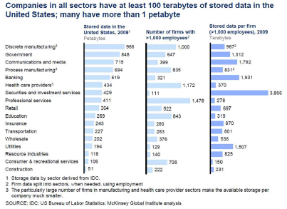

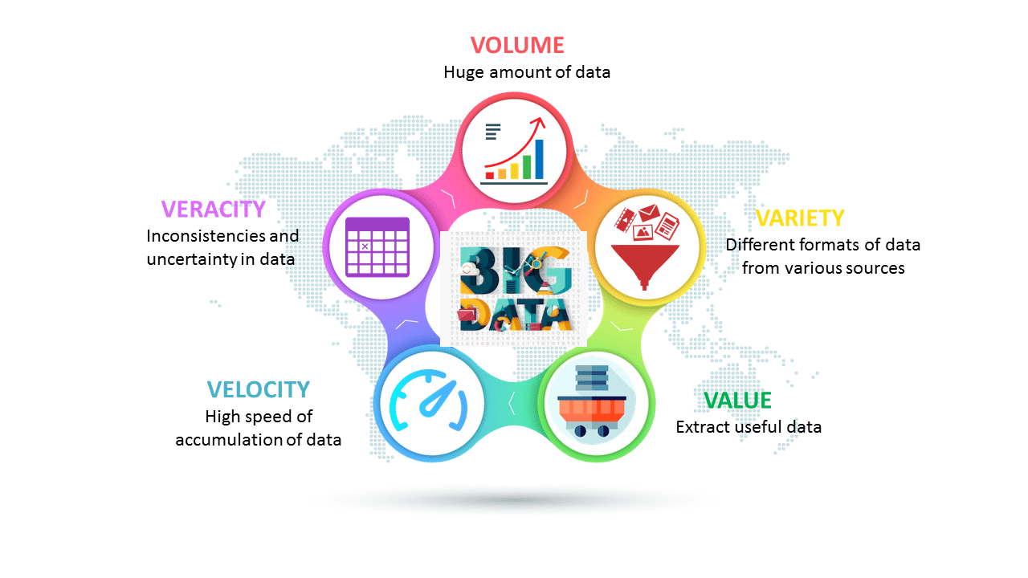
Data Has Become ‘Big ’
5 Vs of a data are ever increasing
➔ Need an effective way to understand them quickly
5 Vs of Big Data
Source: http://hedureka.com

Slide 16
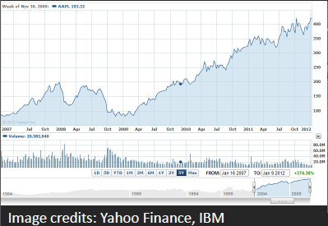
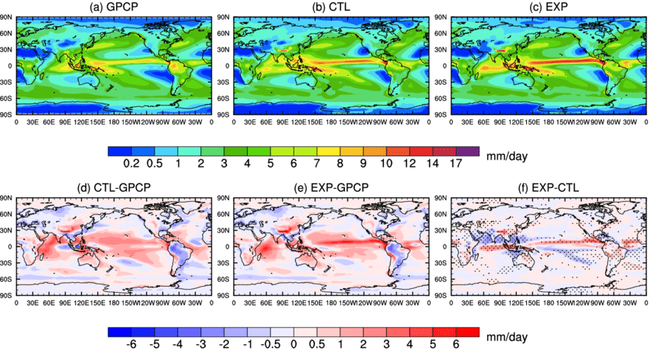
Data Visualization
Visual representation of data
For exploration, discovery , insight ….
Interactive component provides more insight as compared to static images
Image credits: www.researchgate.net

Slide 17
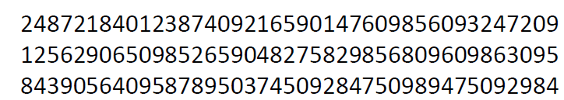
How many 3’s ?
How much time did you take ?
Image credits: www.researchgate.net

Slide 18
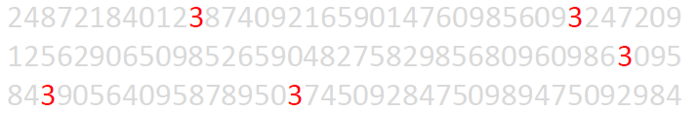
How many 3’s ?
How much time did you take now ?
Pre- attentive Processing:
• Requires attention despite the name
• Very fast: < 200-250 ms
• What matters most is the contrast between features

Slide 19
Highest sales figure for each product?
Annual Sales (in US $)
US States | Product A | Product B | Product C | Product D | Product E
Pennsylvania | 30,934.00 | 30,112.00 | 26,376.00 | 34,459.00 | 44,105.00
Illinois | 49,743.00 | 40,996.00 | 33,527.00 | 45,298.00 | 31,961.00
Ohio | 42,439.00 | 49,024.00 | 43,670.00 | 48,584.00 | 47,183.00
Georgia | 29,344.00 | 41,095.00 | 37,954.00 | 38,337.00 | 34,406.00
North Carolina | 30,443.00 | 31,941.00 | 29,231.00 | 49,090.00 | 41,067.00
Michigan | 41,241.00 | 36,036.00 | 43,715.00 | 34,026.00 | 32,050.00
New Jersey | 40,437.00 | 49,737.00 | 40,207.00 | 46,347.00 | 31,150.00
Virginia | 38,816.00 | 44,372.00 | 35,359.00 | 31,226.00 | 26,563.00
Washington | 30,773.00 | 31,220.00 | 47,950.00 | 36,900.00 | 40,732.00
Georgia | 35,738.00 | 28,715.00 | 29,418.00 | 29,913.00 | 29,859.00
Is it easy to find out ?

Slide 20
Highest sales figure for each product?
Annual Sales (in US $)
US States | Product A | Product B | Product C | Product D | Product E
Pennsylvania | 30,934.00 | 30,112.00 | 26,376.00 | 34,459.00 | 44,105.00
Illinois | 49,743.00 | 40,996.00 | 33,527.00 | 45,298.00 | 31,961.00
Ohio | 42,439.00 | 49,024.00 | 43,670.00 | 48,584.00 | 47,183.00
Georgia | 29,344.00 | 41,095.00 | 37,954.00 | 38,337.00 | 34,406.00
North Carolina | 30,443.00 | 31,941.00 | 29,231.00 | 49,090.00 | 41,067.00
Michigan | 41,241.00 | 36,036.00 | 43,715.00 | 34,026.00 | 32,050.00
New Jersey | 40,437.00 | 49,737.00 | 40,207.00 | 46,347.00 | 31,150.00
Virginia | 38,816.00 | 44,372.00 | 35,359.00 | 31,226.00 | 26,563.00
Washington | 30,773.00 | 31,220.00 | 47,950.00 | 36,900.00 | 40,732.00
Georgia | 35,738.00 | 28,715.00 | 29,418.00 | 29,913.00 | 29,859.00
“The purpose of visualization is insight, not just picture.”
Data visualization pioneer, Ben Shneiderman

Slide 21
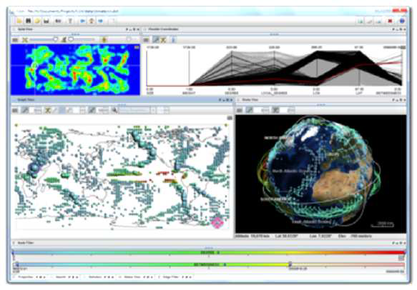
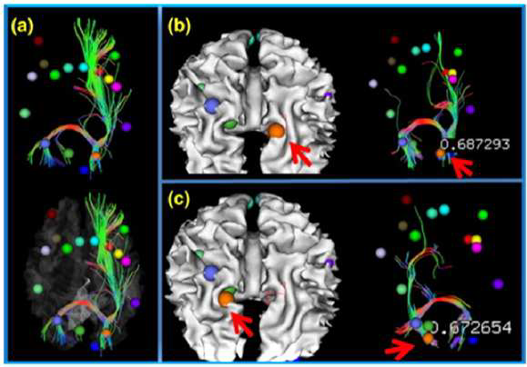
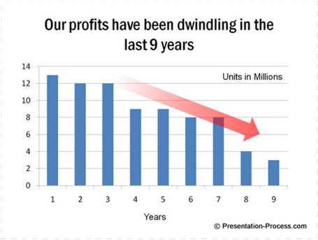
Need for Data Visualization
Tool to enable a user get insight into data
Broadly three types of goals:
• To explore:
Nothing is known
Required to get an insight
To analyze :
There are hypotheses
Used for verification or falsification
To present:
We have the required information
Used for communication of result
Source: Google images

Slide 22
Statistical Visualization
A picture is worth a thousand words!
Bar chart / graph
Histogram
Box plot
Pie chart
Density plot
Line chart
Frequency polygons
Scatter plots

Slide 23
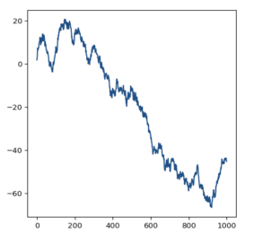
Chart Types
Line charts are great when it comes to displaying patterns of change across a continuum.

Slide 24
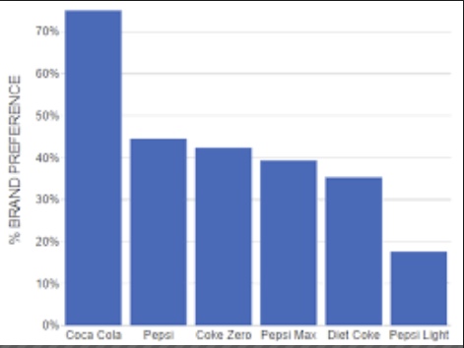
Chart Types
Choose bar charts if you want to compare items in the same category.
The objective is not just to compare but also show how much one is better or worse than the rest.

Slide 25
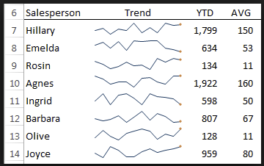
Chart Types
Sparklines usually don’t have a scale which means that users will not be able to notice individual values. They work well when you have a lot of metrics and you want to show only the trends.

Slide 26
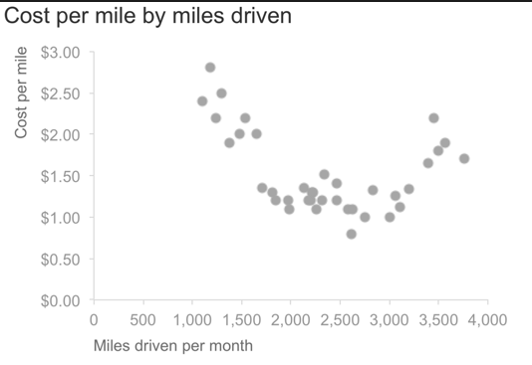
Avoid scatterplots. They lack precision and clarity as the relationships between two quantitative measures don’t change very frequently.

Slide 27
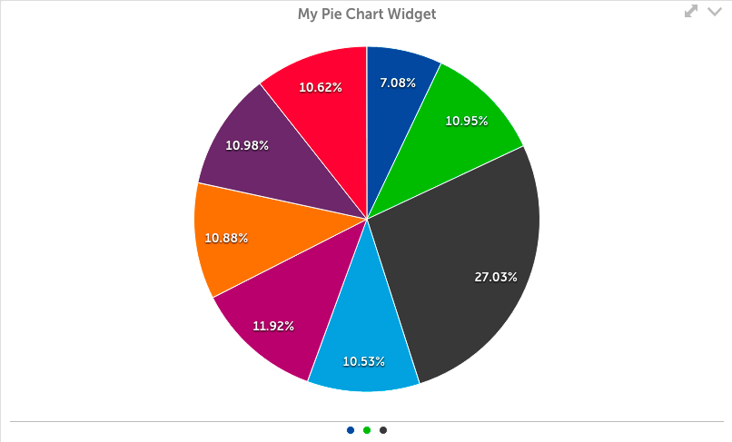
Charts To Avoid
Avoid Pie charts. They rank low in precision because users find it difficult to accurately compare the sizes of the pie slices.

Slide 28
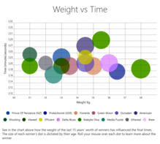
Charts To Avoid
Avoid bubble charts. They require too much mental effort from their users even when it comes to reading simple information in a context.

Slide 29
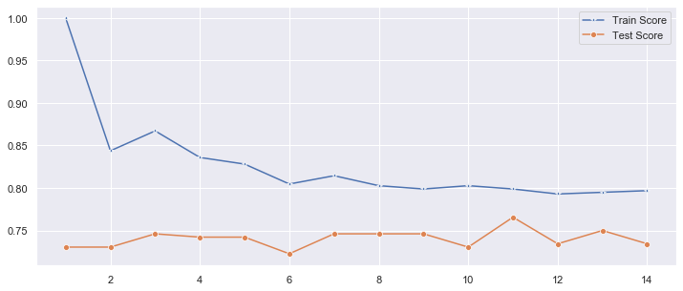

Slide 30
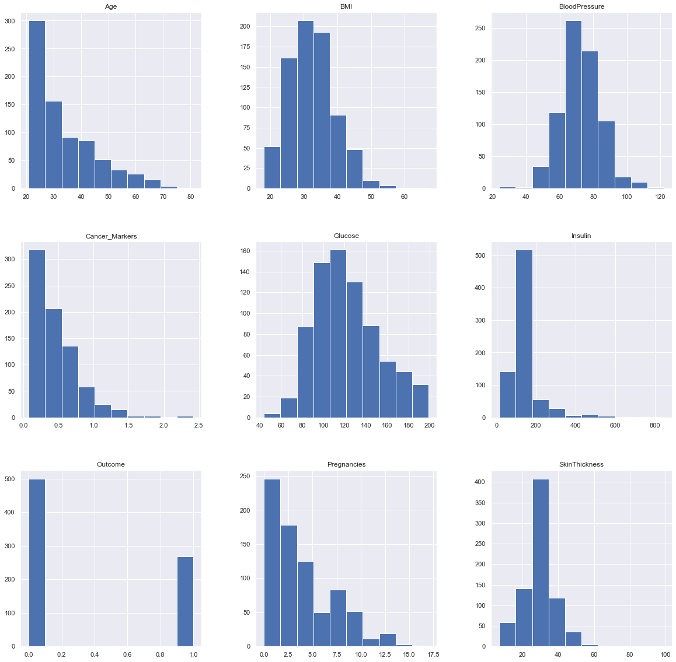

Slide 31
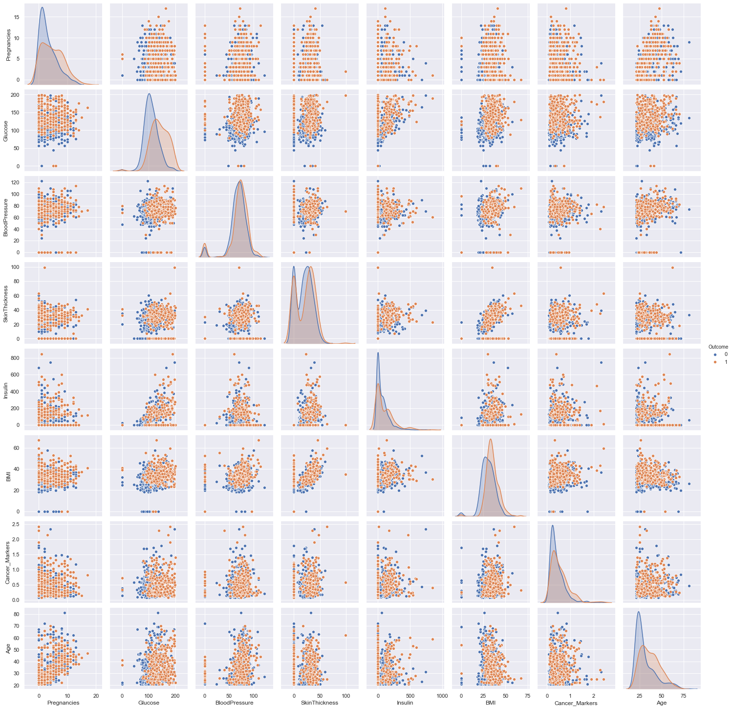

Slide 32
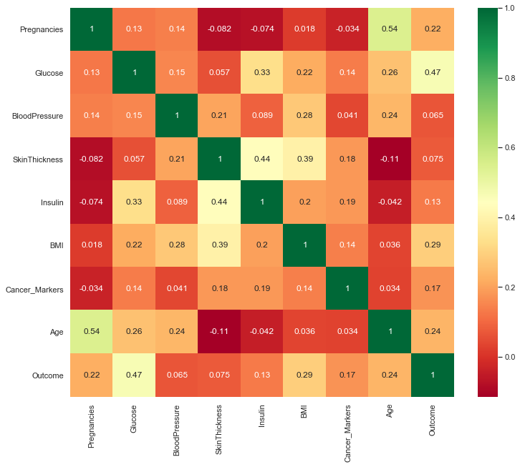

Slide 33
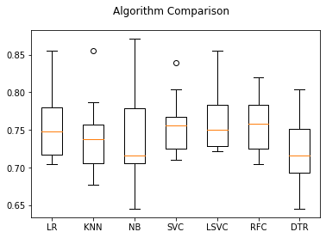

Slide 34
Summary
Cost | Weight | Weight1 | Length | Height | Width
count | 159.000000 | 159.000000 | 159.000000 | 159.000000 | 159.000000 | 159.000000
mean | 398.326415 | 26.247170 | 28.415723 | 31.227044 | 8.970994 | 4.417486
std | 357.978317 | 9.996441 | 10.716328 | 11.610246 | 4.286208 | 1.685804
min | 0.000000 | 7.500000 | 8.400000 | 8.800000 | 1.728400 | 1.047600
25% | 120.000000 | 19.050000 | 21.000000 | 23.150000 | 5.944800 | 3.385650
50% | 273.000000 | 25.200000 | 27.300000 | 29.400000 | 7.786000 | 4.248500
75% | 650.000000 | 32.700000 | 35.500000 | 39.650000 | 12.365900 | 5.584500
max | 1650.000000 | 59.000000 | 63.400000 | 68.000000 | 18.957000 | 8.142000

Slide 35
Measures of Central Tendency
Measures of Variability

Slide 36

Measures of Central Tendency
Measure of central tendency provides a very convenient way of describing a set of scores with a single number that describes the PERFORMANCE of the group.
Also defined as a single value that is used to describe the “center” of the data.
Three commonly used measures of central tendency:
Mean
Median
Mode

Slide 37
Mean
Also referred as the “arithmetic average”
The most commonly used measure of the center of data
Numbers that describe what is average or typical of the distribution
Computation of Sample Mean:
= Σ Y/ N = (Y1 + Y2 + Y3 + … Yn) / N where
“Y bar” equals the sum of all the scores, Y, divided by the number of scores, N.
Computation of the Mean for grouped Data
Where f Y = a score multiplied by its frequency

Slide 38
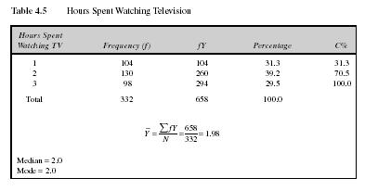
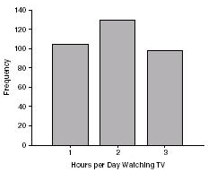
Mean: Grouped Scores
Data of Children watching TV in Bengaluru

Slide 39
Mean
Properties
It measures stability. Mean is the most stable among other measures of central tendency because every score contributes to the value of the mean.
It may easily affected by the extreme scores.
The sum of each score’s distance from the mean is zero.
It can be applied to interval level of measurement
It may not be an actual score in the distribution
It is very easy to compute.

Slide 40
Mean
When to Use the Mean
Sampling stability is desired.
Other measures are to be computed such as standard deviation, coefficient of variation and skewness

Slide 41
The Mode
The category or score with the largest frequency (or percentage) in the distribution.
The mode can be calculated for variables with levels of measurement that are: nominal, ordinal, or interval-ratio.
Example:
Number of Votes for Candidates for Lok Sabha MP. The mode, in this case, gives you the “central” response of the voters: the most popular candidate.
Candidate A – 11,769 votes The Mode:
Candidate B – 39,443 votes “Candidate C”
Candidate C – 78,331 votes
Notes:
For a nominal variable, the mode is the only measure that can be used.
For ordinal variables, the mode and the median may be used. The median provides more information (taking into account the ranking of categories.)
For interval-ratio variables, the mode, median, and mean may all be calculated. The mean provides the most information about the distribution, but the median is preferred if the distribution is skewed.

Slide 42
Mode
Properties
It can be used when the data are qualitative as well as quantitative.
It may not be unique.
It is affected by extreme values.
It may not exist.
When to Use the Median
When the “typical” value is desired.
When the data set is measured on a nominal scale

Slide 43
The Median
The score that divides the distribution into two equal parts, so that half the cases are above it and half below it.
The median is the middle score, or average of middle scores in a distribution.
Fifty percent (50%) lies below the median value and 50% lies above the median value.
It is also known as the middle score or the 50th percentile.

Slide 44
The Median
Median of Ungrouped Data
Arrange the scores (from lowest to highest or highest to lowest).
Determine the middle most score in a distribution if n is an odd number (and if n is an even number, get the average of the two middle most scores)

Slide 45
Median Exercise #1 (N is odd)
Calculate the median for this hypothetical distribution:
Job Satisfaction Frequency
Very High 2
High 3
Moderate 5
Low 7
Very Low 4
TOTAL 21

Slide 46
Median Exercise #2 (N is even)
Calculate the median for this hypothetical distribution:
Satisfaction with Health Frequency
Very High 5
High 7
Moderate 6
Low 7
Very Low 3
TOTAL 28

Slide 47
Median in Grouped Data
Where:
L = Lower boundary of the category containing the N/2
Cf = Cumulative frequency before the median class if the scores are arranged from the lowest to highest value
w = Size of the class interval
f = frequency of the median class

Slide 48
Median in Grouped Data
Steps to solve median for grouped data
Complete the table for Cf.
Get N/2 of the scores in the distribution so that you can identify MC
Determine L, w, f and Cf
Solve the median using the given formula

Slide 49
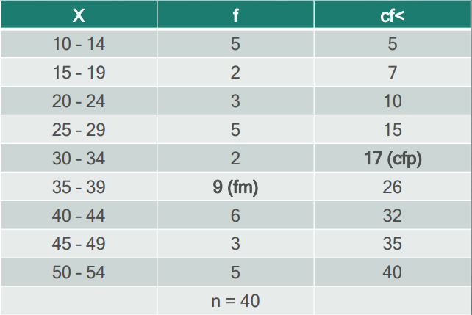
Median
Example: Scores of 40 students in a science class consist of 60 items and they are tabulated below. The highest score is 54 and the lowest score is 10.

Slide 50
Median
Solution:
n/2 = 40/2 = 20
The category containing n/2 is (35 – 39)
Lower Limit of MC = 35
L = 34.5
Cf (or Cfp) = 17
f (or fm) = 9
w = 5
Median = L + (n/2 – Cf) /f * w
= 34.5 +(20-17)/9 *5
= 34.5 + 15/9
= 36.17

Slide 51
Median
Properties
It may not be an actual observation in the data set.
Not affected by extreme values because median is a positional measure.
Can be applied in ordinal level.
When to Use the Median
The exact midpoint of the score distribution is desired.
There are extreme scores in the distribution.

Slide 52
Percentiles
A score below which a specific percentage of the distribution falls.
Finding percentiles in grouped data:

Slide 53
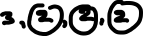
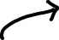
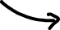
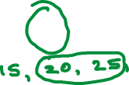
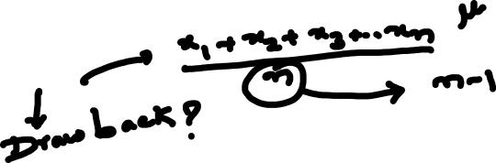
Measures of central tendency
The mean
the median
the mode

Slide 54
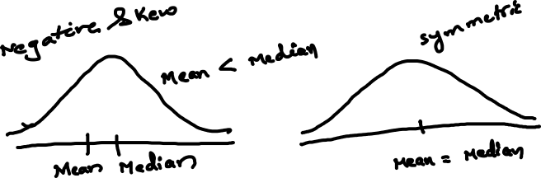
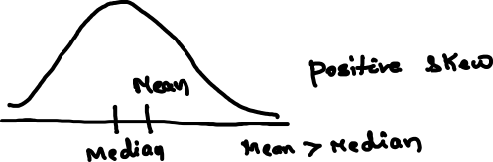

Slide 55
Shape of the Distribution
Symmetrical : mean is about equal to median
Skewed
Negatively : mean < median
Positively : mean > median
Bimodal : has two distinct modes
Multi-modal : has more than 2 distinct modes)
Notes:
Draw Examples on the board

Slide 56
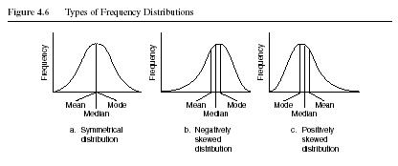
Distribution Shape

Slide 57
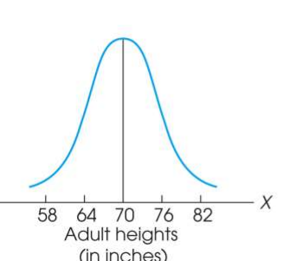
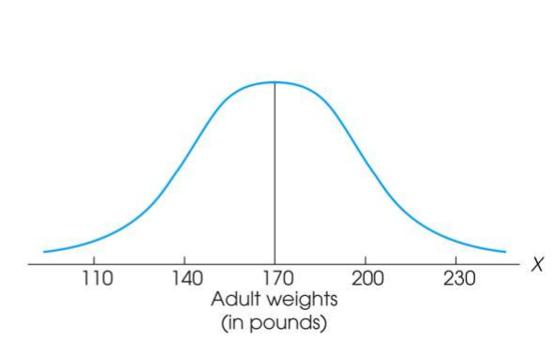
Measure of Variability
Variability can be defined several ways:
A quantitative distance measure based on the differences between scores
Describes distance of the spread of scores or distance of a score from the mean
Purposes of Measure of Variability:
Describe the distribution
Measure how well an individual score represents the distribution

Slide 58
The Three Measures
Three Measures of Variability:
The Range
The Variance
The Standard Deviations

Slide 59
The Ranges
The distance covered by the scores in a distribution – From smallest value to highest value
For continuous data, real limits are used
Based on two scores, not all the data – An imprecise, unreliable measure of variability
Range = URL for X_{max} - LRL for X_{min}
Example: For a set of scores: 7, 2, 7, 6, 5, 6, 2
Range = Highest Score minus Lowest score = 7 - 2 = 5

Slide 60
The Standard Deviation
Most common and most important measure of variability is the standard deviation
A measure of the standard, or average, distance from the mean
Describes whether the scores are clustered closely around the mean or are widely scattered
Calculation differs for population and samples
Variance is a necessary companion concept to standard deviation but not the same concept

Slide 61
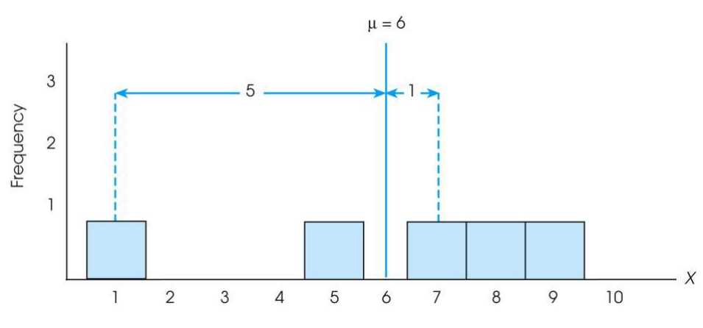
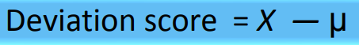
The Standard Deviation
Exercise : Find out the deviations of all the data points with the mean….and then find the ‘mean deviation’.

Slide 62

The Standard Deviation
Mean deviations will always be ‘zero’ !
(because Mean is a balance point)
Then, how do you find ‘Standard Deviation’ ?
Need a new strategy

Slide 63
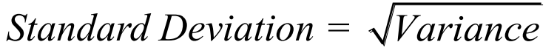
The Standard Deviation
New Strategy :
First square each deviation score
Then sum the Squared Deviations (SS)
Average the squared deviations
Mean Squared Deviation is known as “Variance”
Variability is now measured in squared units

Slide 64


The Variance
Variance equals mean (average) squared deviation (distance) of the scores from the mean
where

Slide 65
The Population Variance
Population variance equals mean (average) squared deviation (distance) of the scores from the population mean
Variance is the average of squared deviations, so we identify population variance with a lowercase Greek letter sigma squared: σ 2
Standard deviation is the square root of the variance, so we identify it with a lowercase Greek letter sigma: σ

Slide 66
Learning Check
If all the scores in a data set are the same, the Standard Deviation is equal to 1.00
The standard deviation measures …
(1) Sum of squared deviation scores
(2) Standard distance of a score from the mean
(3) Average deviation of a score from the mean
(4) Average squared distance of a score from the mean
True / False ?
Select the correct option

Slide 67
Solution
If all the scores in a data set are the same, they are equal to the mean and hence the deviation from mean = 0 therefore, Standard Deviation is equal to zero
The standard deviation measures …
(1) Sum of squared deviation scores
(2) Standard distance of a score from the mean
(3) Average deviation of a score from the mean
(4) Average squared distance of a score from the mean
False

Slide 68
Standard Deviation and Variance for a Sample
Goal of inferential statistics:
Draw general conclusions about population
Based on limited information from a sample
Samples differ from the population
Samples have less variability
Computing the Variance and Standard Deviation in the same way as for a population would give a biased estimate of the population values

Slide 69


Sample Standard Deviation and Variance
Sum of Squares (SS) is computed as before
Formula for Variance has n-1 rather than N in the denominator
Notation uses s instead of σ
Population of Adult Heights

Slide 70
Degrees of Freedom
Population variance
Mean is known
Deviations are computed from a known mean
Sample variance as estimate of population
Population mean is unknown
Using sample mean restricts variability
Degrees of freedom
Number of scores in sample that are independent and free to vary
Degrees of freedom (df) = n – 1

Slide 71
Learning Check
Select the correct option
A sample of four scores has SS = 24. What is the variance?
The variance is 6
The variance is 7
The variance is 8
The variance is 12
A sample systematically has less variability than a population
The standard deviation is the distance from the Mean to the farthest point on the distribution curve
True / False ?
True / False ?

Slide 72
Solution
Select the correct option
A sample of four scores has SS = 24. What is the variance?
The variance is 6
The variance is 7
The variance is 8
The variance is 12
Extreme scores affect variability, but are less likely to be included in a sample
The standard deviation extends from the mean approximately halfway to the most extreme score
True
False

Slide 73


Biased and Unbiased Estimates

Slide 74

Descriptive Statistics
A standard deviation describes scores in terms of distance from the mean
Describe an entire distribution with just two numbers (M and s)
Reference to both allows reconstruction of the measurement scale from just these two numbers
Means and standard deviations together provide extremely useful descriptive statistics for characterizing distributions

Slide 75
Interquartile range (IQR)
Measure of Variation
Also Known as Midspread: Spread in the Middle 50%
Difference Between Third & First Quartiles:
Not Affected by Extreme Values
Interquartile Range = Q₃ – Q₁
Data in Ordered Array: 11 12 13 16 16 17 17 18 21
1•(9 + 1)
Position of Q₁
=
= 2.50,
Q₁
=12.5
4
3•(9 + 1)
Position of Q₃
=
= 7.50,
Q₃
=17.5
4
Interquartile Range = Q₃ – Q₁ = 17.5 - 12.5 = 5

Slide 76
Box and Whisker plot
97.5th Centile
75th Centile
Q₁
MEDIAN
(50th centile)
Q₂
25th Centile
Q₃
Inter-quartile range
2.5th Centile

Slide 77
Box and Whisker plot
IQR = Q₃ – Q₁
Q₁-1.5 IQR
Q₃+1.5 IQR
Min
Max
Q₁
Q₂
Q₃
Outlier
Outlier

Slide 78
Box-and-Whisker plot
IQR = Q₃ – Q₁
Min
Q₁-1.5 IQR
Q₃+1.5 IQR
Max
Q₁
Q₂
Q₃
Q₃+3 IQR
Q₁-3 IQR
Major Outlier
Major Outlier

Slide 79
Probability

